Slide 1

Beirut Dubai Silicon Valley
www.mevp.com

Slide 2















Middle East Venture Partners is MENA’s pioneer VC with $100M+ in AUM
25
15
Companies
we invested in
$100+ million
Co-investors
we partnered with
raised so far in
4
Funds
- Middle East Venture Fund
- Building Block Equity Fund
- IMPACT Fund
- Middle East Venture Fund II
300+
... and counting!
Jobs created

Slide 3
All indicators are in favor of a growing digital economy
Nominal GDP per capita in the Arab World (USDs)
Smartphone Users in the Arab World (2014) (in Millions)
Crude
oil price (USD/
barrel)
Penetra-tion
Rate (%)
113%
33%
121%
105%
107%
50%
28%
64%
79
111
112
109
101
CAGR: 2.4%
2014E =83M
Arab Spring
Internet users in the Arab World (in Millions)
E-commerce Growth in the Arab World (USDs in Billions)
CAGR: 12%
CAGR: 21%
Source: World Bank, KPCB, Internet World Stats, PayPal, IPSOS, MEVP analysis, Informa IC, PayTabs, WSJ, Ernst & Young

Slide 4
Growing digital economy generates more Venture Capital investments
CAGR 57%
The Venture Capital industry in the Arab region is set to grow five-fold in the next three years, propelled by higher smartphone and internet penetration, rising e-commerce sector and a growing economy
Venture Capitalists have increased their funds size from $10-15M a few years back to $30-70M today
Source: Zawya, MENA Private Equity Association – 4th Venture Capital in the Middle East and North Africa Report.

Slide 5
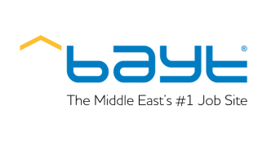
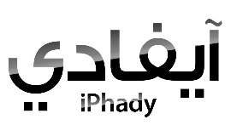






















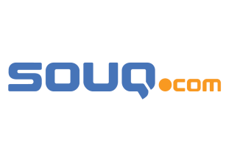













Successful Exit stories such as Souq.com, Zawya.com and Shahiya.com have proven that VC can be lucrative in MENA
Acquirers
Beam Wallet
2006
to
2010
2011
2012
2013
2014
2015
Lebanese companies

Slide 6
Lebanon is the largest market in the region in terms of number of transactions, total number of deals growing at a CAGR of 13%
Overview
VC Deals by Country
Since 2012, the VC and start-up landscape in Lebanon has witnessed a strong development in its ecosystem’s infrastructure
Various stakeholders have contributed in the reshape of the Lebanese market: Berytech, Bader, LFE/LIFE , BIAT, SouthBic
The Central Bank has launched an initiative through Circular 331, bringing more than $400M of capital into the Lebanese start-up ecosystem
However, the ecosystem still needs further maturity as there might be limited deal flow that warrants large amounts of capital
At the seed stage, there’s a clear lack of high quality guidance, of liquidity and mentorship and hence the Lebanese market needs additional incubators
Lebanon accounts for almost 10% of the total number of transactions in MENA region
CAGR 12%
Major Stakeholders
VCs | MEVP, Berytech Fund, Wamda Capital, Leap Ventures
Incubators | Berytech, BIAT, South BIC, Speed@BDD
NGOs | LebNet, Bader, MIT Enterprise Forum, Endeavor
Prominent Lebanese Start-ups | Dermandar, Anghami, Instabeat, Apstrata, Mobinets, Diwanee, Shahiya, B.A.S., Bookwitty, Multilane
Sources: Arabnet, Zawya Private Equity Monitor Notes: Ind. Man. refers to Industrial Manufacturing

Slide 7
Number of VC Deals in MENA and Lebanon
Total Number of Deals = 56
Total Number of Deals = 119
Total Number of Deals = 139
Deals in
Lebanon = 4
Deals in
Lebanon = 25
Deals in
Lebanon = 28
Sources: MENAPEA report 2012, 2013, 2014

Slide 8











Landscape of the Lebanese ecosystem: lack of business angels and seed capital
Lack of equity investments, high quality guidance, liquidity and mentorship. The Lebanese market needs more and smarter business angels
Private Equity
Venture Capital
Lebanese Banks
Seed
Division 1 (Soon)
$10K to $500K
$500K to $5M
$20M and more
Mentorship
Idea
Market research
Mentorship
Expansion and development
Business planning
Revenue realization
De-leveraging
Cash flow optimization
Scale

Slide 9


Multiple funds are present in Lebanon
0 exits
2 exits
0 exits
0 exits
Date of Launch | 2008 | 2010 | 2011 | 2014
Office Locations | Beirut | Beirut Dubai | Beirut, Dubai, Amman | Beirut
Geographical Scope | Lebanon | MENA | MENA Turkey | MENA
AUM | $56M | $100M+ | $95M | $71M
Number of Funds | 1 + 1 in the pipeline | 4 | 1 + 1 to be launched led by Fadi Ghandour | 1 (Launched June 14 as a result of BDL Circular 331)
Ticket Size | $100K - $1.2M | $500K - $5M+ | $1M - $3M | $3M - $7M
Number of Investments | 15+ | 24 | 10+ | 0
Sectors | ICT | ICT | ICT Education | ICT
Sources: Crunchbase, Entrepreneurs Lebanon, MENA Opportunities
Notes: ** Have invested in Lebanese start-ups

Slide 10




The rise of VC in Lebanon coincides with more entrepreneurial support within NGOs, incubators and technology parks
BADER
A community of inspired and committed young business leaders engaged in supporting entrepreneurs and promoting small businesses
Berytech
Provides hosting support for start-ups, no incubation services
Business Incubation Association in Tripoli (BIAT)
Aims to identify, incubate, host, network, train and support value-added business opportunities. Funded by the EU delegation in Lebanon
South Business Innovation Center (South BIC)
Aims to identify incubate, host, network, train and support value-added business opportunities . Funded by the EU delegation in Lebanon
SPEED@Beirut Digital District (@BDD)
Proposed SPV by MEVP, Berytech and BLC Bank targeting start-ups in early stage high-impact sectors (mobile apps, cloud computing, social media, etc.)
Endeavor Lebanon
A non-profit economic development organization engaged in selecting, mentoring and accelerating already successful entrepreneurs with at least $1M in annual revenue
MIT Enterprise Forum of the pan-Arab region
MIT Enterprise Forum’s Chair is an angel investor in start-ups in the Middle East and Europe, and has launched a co-working space in Beirut called Coworking+961
Sources: MENA Private Equity Association

Slide 11
Business Plan Competitions also contribute in the development of the ecosystem
Competition | Partners | Description
MIT Arab Business Plan Competition | Bader, MIT | Regional business plan competition
Startup Cup | Bader | Business plan competition
Grow my Business | Bader, Bank Audi | Business plan competition
Intel Berytech Innovation Challenge | Berytech, Intel, Potential | Regional technology business plan competition
Global Social Venture Competition | Berytech, USJ, BLC Bank | Social Entrepreneurship/ innovation contest
NMPC | Balamand, Berytech, MOT, Touch, Samsung | Mobile development
Digital Arabic Content | Berytech, Escwa | Competitions for digital Arabic content
Women Entrepreneurs | Berytech, AUF, BLC Bank | Projects initiated by women
Microsoft Bizspark | Microsoft, Berytech | Access to Microsoft software support programs
SoftLanding | Berytech | Access to international markets
WE Initiatives/SME Toolkit | BLC Bank | Support initiatives for entrepreneurs
Touch Cloud | Touch, MOT | Mobile development-Cloud based back‐end service
Sources: MENA Private Equity Association

Slide 12
Government and semi- government entities in Lebanon also trying to support the Lebanese start-ups scene
Government and semi- government entities in Lebanon support the Lebanese start-ups scene by promoting entrepreneurial initiatives, offering funding opportunities and grants and by organizing networking events
Entity | Field
Chambers of commerce | Business support
Council of Ministers | Business support
IDAL | Investment and business support (tax waive)
Lebanon SoftShore Cluster | Software and development services
Ministry of Telecommunications | Technology support program-infrastructure
Ministry of economy and trade | SME support programs and LibanPost one stop shop
Ministry of Finance | Import-Export
INEFFICIENT
Sources: MENA Private Equity Association

Slide 13

Lebanese success stories: Shahiya’s - # 1 food portal in the Arab World exit in 2014
Shahiya.com acquired by the largest Japanese recipe website Cookpad
EXITED
in Dec 2014
About
the acquisition
$13.5m
For 100% ownership
CAGR
200%
130% IRR
6x
Cash-on-cash
exit multiple

Slide 14

Lebanese success stories: Bookwitty - Global book distributor and reseller
EXITING
SOON
3.5x cash on cash
CAGR
45%
CAGR
58%

Slide 15

Lebanese success stories: Anghami -MENA’s leading and fastest growing music streaming business
Next >$100M exit
CAGR
87%

Slide 16
5 Major challenges to Lebanon’s start-up scene
Legal and Logistical Infrastructure
Lack of expertise and mentorship
Lack of online ads monetization capabilities
Limited access to smart capital
Networking and Internationalization

Slide 17
IT Infrastructure is horribly trailing behind
Lebanon ranks 174th globally in terms of average internet speeds, even outranked by countries in turmoil such as Palestine and Iraq.
Sources: Net Index, Akamai

Slide 18
All of which leads to a negative economic impact
“The impact on the Lebanese economy not to embrace broadband now would be the equivalent of Lebanon not to have embraced learning foreign languages a generation ago.” – World Bank
“Only three qualifying countries had lower average connection speeds [in Q2 2014] as compared to the second quarter of 2013: El Salvador (down 17%), the Dominican Republic (down 13%), and Lebanon (down 1.7%).” – State of the Internet, Akamai
Sources: Ogero, Net Index, Akamai

Slide 19
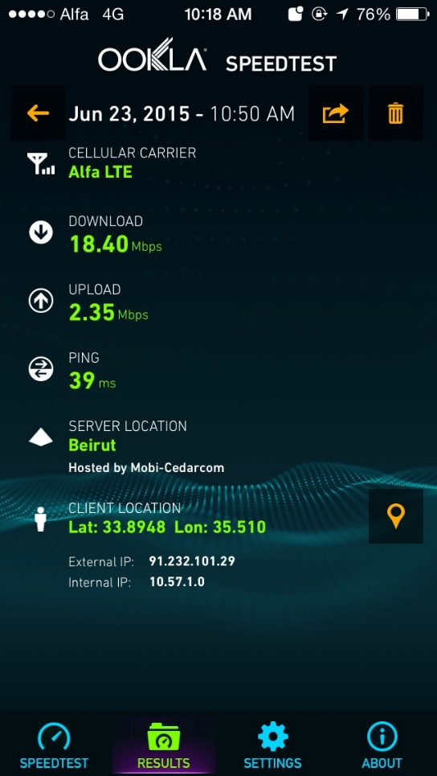
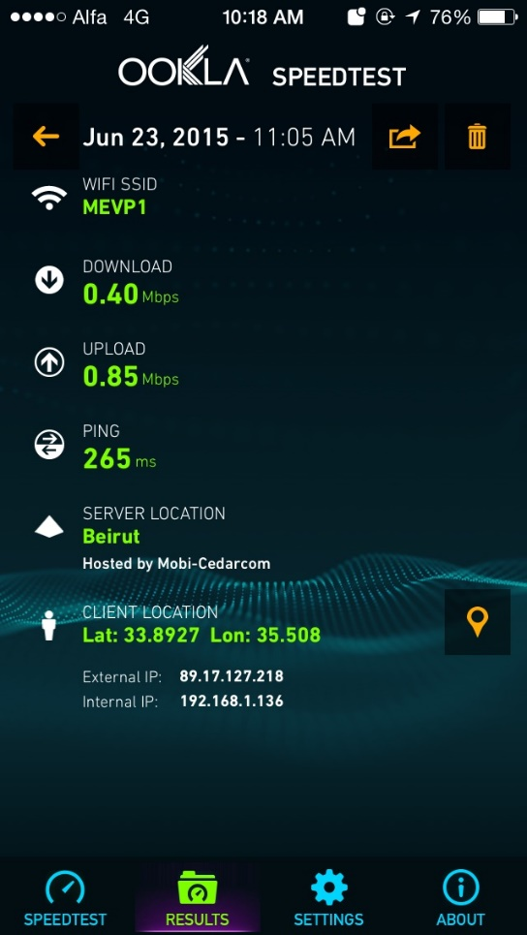
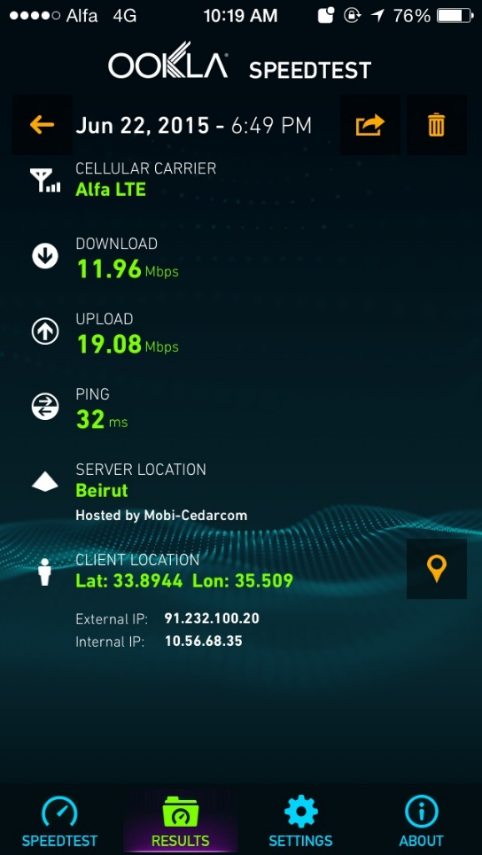
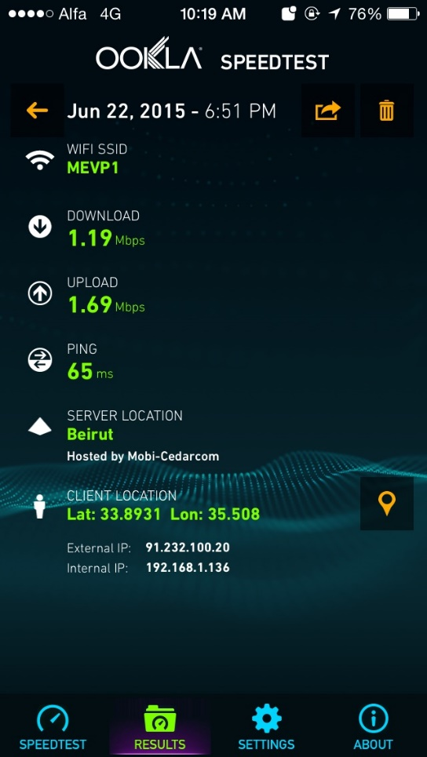
MEVP Speeds: A Real Life Case
3G – Morning Test
WIFI – Morning Test
3G – Evening Test
WIFI– Evening Test
A download speed as low as 0.4 Mbps can be witnessed, through a 2.3Mbps HDSL Ogero subscription (costing 125,000L.L. per month for a mere 80 GB consumption + 2000 L.L. for every extra GB)

Slide 20
Ending Note
VCs require faster internet to empower economic development and create knowledge-based jobs

